Slide 1
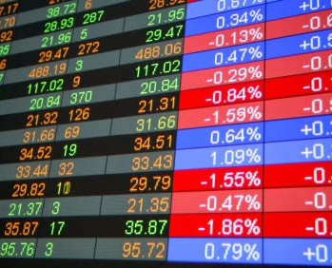
Business news mining and impact on stock price
Yong Keh Soon (WQD 180065)
Supervisor: Associate Prof. Dr. Ow Siew Hock
Notes:
NOTE:
To change the image on this slide, select the picture and delete it. Then click the Pictures icon in the placeholder to insert your own image.

Slide 2
Agenda
Background Study
Literature Review
Problem Statements
Research Questions
Research Objectives
Research Scope
Research Methodology

Slide 3

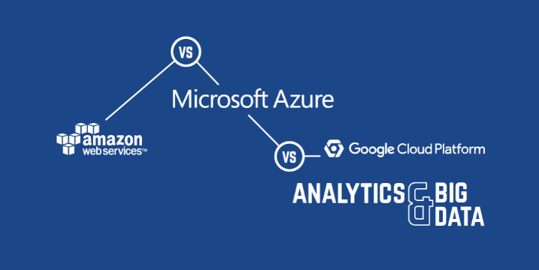

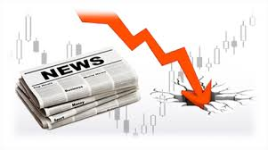






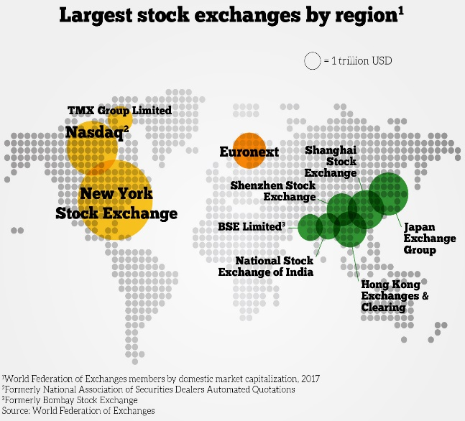
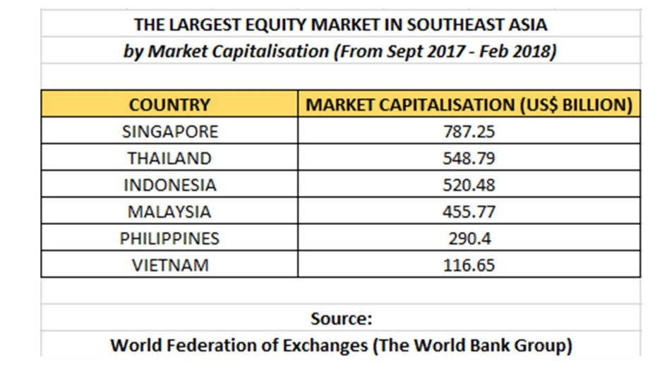


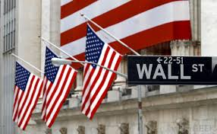
Background Study
Research Shown News Impact Stock Price
News Integrated Trading Strategy Improves Return
Massive Online News Resources
Many Text Analytic Tools
Very Little Research on KLSE Stock Price Reaction to News
Most Research Conducted on World Largest Stock Market at Wall Street
KLSE Listed 1000 Companies With Market Cap of $455b

Slide 4
Literature review

Slide 5
 | Author | Data Source | News Filtering | Features | Features Selection and Reduction | Feature Representation | Predict | Machine Learning | Findings, Strengths/Weaknesses
1 | [Tetlock, 2007] | WSJ Abreast of the Market column 1984-1999 | None | Unigram Volumes | Harvard IV Dictionary, mapped to 77 categories PCA to derive pessimism score. “Weak” and “Negative” category explains 57% of variation | Article Sentiment Score based on Ratio of Negative Words over Total words | Dow Jones Industrial Return based on SMB (small-minus-big) | VAR -vector auto regression | High pessimism predicts stock price downward, followed by reversion to fundamental. Coefficient at 5% significant level Harvard IV categories is built on physiology data, may not correctly reflect tone in finance
2 | [Tetlock at el., 2008] | Dow Jones News Service Wall Street Journal S&P 500 stocks 1980-2004 | Firm names appear in fist 25 words | Unigram Fundamental variables such as earning and expected return | Harvard IV Dictionary, mapped into only Positive/Negative Category | Article Sentiment Score based on Ratio of Negative Words over Total words | Firms’ stock return | VAR -vector auto regression | Fraction of negative words in firm-specific news forecast low earnings Firms’ stock prices briefly underreact to the information embedded in negative words; and Fundamental related news has the largest predictability power on firm’s earning and stock price returns Stronger prediction model which considered fundamentals indicators

Slide 6
 | Author | Data Source | News Filtering | Features | Features Selection and Reduction | Feature Representation | Predict | Machine Learning | Findings, Strengths/Weaknesses
3 | [Loughran and McDonald, 2011] | 10K Filing 1994-2008 | Data already tagged to stock in source | Unigram | Harvard IV Dictionary | TF-IDF | Firms’ stock return | Correlation | Concluded that 73.8% negative words in HVD-4 dictionary are not negative in Finance domain Manual negative word list which more correctly reflect negative tone in financial text
4 | [Hagenau et al., 2012] | German and UK Corporate Announcement Pricing data from Datastream 1998-2010 | News source already tagged to company 50 words minimum in article | 2-Gram 2-Words Combo | 2-Gram 2-Words Combo Noun Phrase removal Select high value features based Chi-square and Bi-Normal separation with exogenous market feedback | Log of word frequency in a message | Stock Direction | SVM | Test Accuracies: Unigram (55.6%), 2-Gram (58.9%), Noun Phrase (61.2%) and 2-Word Combo (63%) Chi-square feature selection improved accuracy for all features type, approx. 5% Feature selection also reduced overfittings shown by reduction in training accuracy but improve in test accuracy Feature selection incorporated market feedback, in feature selection produce better result 50 minimum words filter may limit potential useful observations

Slide 7
 | Author | Data Source | News Filtering | Features | Features Selection and Reduction | Feature Representation | Predict | Machine Learning | Findings, Strengths/Weaknesses
5 | [Schumaker and Chen, 2009] | S&P 500 Stocks Yahoo Finance Oct-Nov 2005 | News already tagged to stock by news provider | Unigram | Bag of words Noun Phrases Proper Noun Named Entity Minimum three occurrences per article | Binary | Stock Direction | SVM | Average 57.1% directional accuracy on different feature types. Best accuracy at 58% when using Proper Noun feature Simulated return average at 2.06 First attempt to explore using Noun as feature Using Noun as predictor is counter intuitive, active result could be overfitting with just one month of data
6 | [Nassirtoussi at el., 2015] | EUR/USD currency pair from FXCM News from MarketWatch (header only) 2008-2011 | None | Unigram | Stop words Removal WordNet Dictionary Hypernyms with WordNet Sentiment Score using SentiWordnet | SumScore (combined positive and negative score) weighted by TF-IDF | Forex Pair Direction | SVM, remodeling every 2 hours | Accuracy of 83.33% on test sample 2-hours sliding window modeling uses most recent data for prediction, given very good result Multi-layered dimension reduction method reduced modeling time Uncommon way to measure sentiment by magnitude rather than direction Only single source of news limits the number of observations

Slide 8
 | Author | Data Source | News Filtering | Features | Features Selection and Reduction | Feature Representation | Predict | Machine Learning | Findings, Strengths/Weaknesses
7 | [Li et al., 2014] | 50 Stocks in Hong Kong Stock Exchange News from FINET 2003-2008 | News already tagged to stock by news provider | Unigram | Use Harvard IV (HVD), Loughran McDonald (LMD) and Sentinet (SN) Dictionary to construct sentiment space Stop words removal | Sentiment Score | Stock Price Direction | SVM | Minor differences in accuracy on different dictionary used Dictionary based approach achieve better result then bag of words Sentiment polarity alone does not perform well in all test (<50% accuracy, with exception of Financial sector stocks) Defined a range Neutral return, rather than absolute zero Study covers both individual stock, and Sector Manually annotated dictionary is not scalable
8 | [Kim at el, 2014] | KOSPI Index (Korea) News from two media company 2011 | None | Unigram | Stop words removal Noun removal Develop automated wordlist (based on stock price direction) from most frequent 700, to derive word sentiment score using TF-IDF | Article Sentiment Score calculation not mentioned | Stock Direction | None | Best tuned accuracy of 65.2% in prediction price direction, F1 score of 62.6% Automated annotation is fast and scalable Result could be bias when automated annotation is based on only just one year timeframe

Slide 9
No | Author | Data Source | News Filtering | Feature | Features Selection and Reduction | Feature Representation | Predict | Machine Learning | Findings
9 | [Tan at el., 2014] | BERNAMA, TheStar, Sun Daily and NST KLSE Stocks 2013 (6 months) | None | Uni-gram | Stop words removal Stemming Develop manual word list of 8000 terms into positive/negative | Article Sentiment Score based on ratio of Positive over Negative word counts, applied on Headers and Body with different weightage | Stock Direction | None | Accuracy of 90.8% when sentiment on both article and body are equally important. Apply stemming improved accuracy by 5% Experiment design considered weighted impact of header and article, which mimic human reading pattern High accuracy could be a result of data mining because data period is only 6 months Manual annotated word list is hard to scale
10 | [Hor at el., 2018] | KLSE top 10 large capital stocks from Trading Service sector The Edge news 2012-2017 (dividend periods only) | Entity match-ing using Azure Text Analy-tics | Uni-gram | Stop words removal | Article Sentiment Score provided Azure Text Analysis service (pre-trained model) | Stock Price Direction | None | Majority news were classified as Neutral by Azure, hence correlation to price direction were nearly null Experiment design and deployment is simple using cloud Scope on dividend period limiting data points for stock sentiment analysis Alternative sentiment measure and tuning not explored

Slide 10
Common Method (Machine Learning Based)
General Inquirer Harvard IV
Custom word list
Dictionary
Stock Price
Label (Price / Direction)
News (Text)
News Selection
Features
Feature Selection & Reduction
Feature Representation
Model
Predict
Keyword Matching
Original news source tagging
N-Gram
Words Combo
Indicators
Noun Word
Noun Phrase
Named Entity
Stop Words removal
Noun Removal
Minimum occurrence
First N words
Filter text on Dictionary categories
Header and/or Body text
Select high performance terms using Statistical on exogenous feedback
Binary (Presence)
Term Frequency (TF)
Log (TF)
TF-IDF
Sentiment Score or equivalent
SVM
VAR
Stock Price (regression)
Price Direction (classification)
Fundamental Data (numeric)
[Tetlock, 2007], [Tetlock et al., 2008], [Loughran and McDonald, 2011], [Hagenau et al., 2012],
[Schumaker and Chen, 2009], [Nassirtoussi et al., 2015], [Li et al., 2014]

Slide 11
Common Method (Sentiment Based)
General Inquirer Harvard IV
SentiWordNet
Custom Scorer
Dictionary
Sentiment Scorer
Stock Price
Label (Price Direction)
News (Text)
News Selection
Features
Feature Selection & Reduction
Feature Representation
Classify
Predict
Keyword Matching
Original news source tagging
Unigram
Categorize Word
Filter text on Dictionary categories
Header and/or Body text
Sentiment Scoring
Sentiment Scoring
Classification:
Positive
NoChange
Negative
Price Direction (classification)
Up
NoChange
Down
[Li et al., 2014], [Kim et al., 2014], [Tan et al., 2014], [Hor et al., 2018]

Slide 12
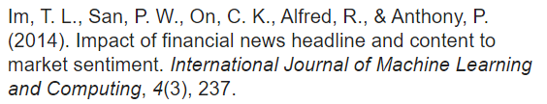
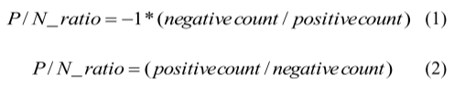
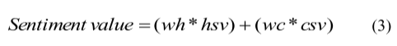
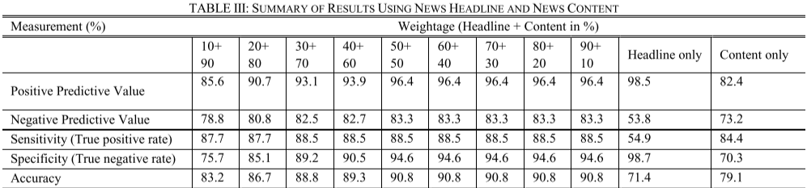
Literature Review 4 (2014)
The author analyzed business related news from BERNAMA, TheStar, Sun Daily and NST. The dataset has 200 news for first 6 months in 2013.
A dictionary with 8000 manually annotated words that were labeled Positive or Negative.
Sentiment is measured on ratio of positive and negative words
The experiment concluded that:
Better accuracy with stemming when analyzing headlines or body
Better accuracy when both headline and body sentiment are used as separate feature. Optimal accuracy of 90.8 achieved when 50-50 weight being applied to headline-body sentiment
However it is not clear to which stock the research is conducted against
Authors suggest future work of analyzing phrase rather than just individual words, and use SentiWordnet as lexicon
[Tan at el., 2014]

Slide 13
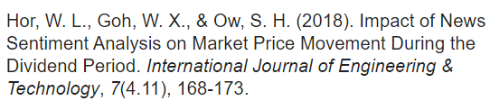
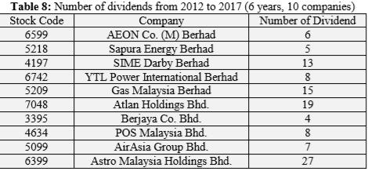
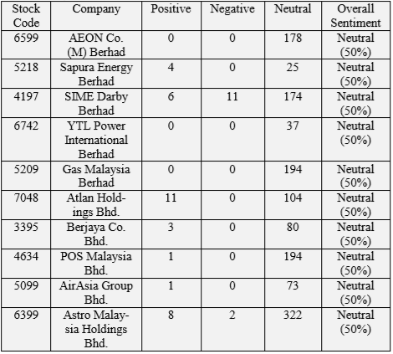
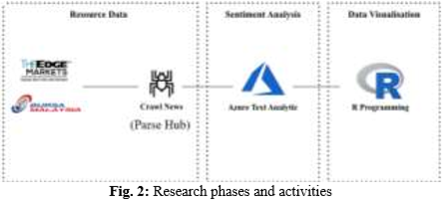
Literature Review 3 (2018)
[Hor at el., 2018]
The author analyzed 10 large capital Malaysian stocks within Trading Services sector from 2012 to 2017 (7 years), specifically during dividend period as announced through Bursa.
Azure Text Analysis analyzed company news from The Edge (finance media). Sentiment scoring from Azure are studied with stock return.
The author suggested broadening the news source for more data to longer period and include other sectors
Dividends issuance events in 6 years
Majority news were classified as Neutral by Azure, hence correlation to price direction were nearly null
Unstructured data is ‘cleaned’ in ParseHub
Sentiment scoring in Azure
Result analyzed in R

Slide 14
Problem statements, research questions, Objectives and scope

Slide 15
Problem Statements
Limitation of current Sentiment Analysis researches on Stocks Price:
Lacking of research of news impact on KLSE
Limited KLSE stocks research period:
6 months period (Tan at el., 2014)
Dividend period only (Hor at el., 2018)
Impact of different news category to stock price not explored

Slide 16
Research Questions
Is there any significant relation between news sentiment and short-term stock price direction ?
Between sector news and stock specific news, is there any difference in their impact on stock price direction ?

Slide 17
Research Objectives
To find out how well news can be used to predict short-term stock price direction
To investigate which news categories (sector news, stock specific news) shows greater impact on stock price direction

Slide 18
Research Scope
Stock Universe
Bursa Financial Services
Bursa Telecommunication & Media
Select stocks that has price volatility, volume and enough news coverage. Initial candidates are top 10 largest market capital stocks for each sector.
Chosen stock must “survived” for the past 10 years.
Local Mainstream News Provider
The Star (business section)
The Edge
Duration: 2010 – 2019 (10 years)
Data is obtained through web scraping directly from news provider website and google query search on the provider

Slide 19
Research methodology

Slide 20
Proposed Method (Sentiment-Based)
General Inquirer Harvard IV
SentiWordNet
Dictionary
Sentiment Scorer
Stock Price
Stock-Specific News
Features
Feature Selection & Reduction
Feature Representation
Train Data
Test Data
Label (Price Direction)
Aggregate Score
and
Classify
Model Prediction
Analyze
Performance
News
(Text)
Separate into Header and Body
Break into sentences
Part Of Speech Tagging
Categorize using Keyword Matching
Unigram
Sentiment Scoring
Sentiment Scoring
Classification:
Positive
Neutral
Negative
Price Direction (classification)
Up
No change
Down
Accuracy
F1 Means
Precision
Recall
Sector News
Features
Feature Selection & Reduction
Feature Representation

Slide 21

Measuring Sentiment Score and Classification
Scored by SentiWordNet 3.0
A variation from [Nassirtoussi at el.,2015, Li at el., 2014 and Tan at el., 2014]
P
Positive Word
[Nassirtoussi at el.,2015, Li at el. 2014]
$$Sentiment Score=\frac{Total P}{Total P+Total N}$$
This ratio is used to ensure score range between 0 and 1. Hence, normalization or scaling is not required.
O
Neutral Word
N
Negative Word
Note:
News articles are categorized into Sector and Stock-Specific news. Study on impact of each and combine categories are carried out
If multiple news available on same day, they are aggregated using average
Stock-Specific News
P
O
P
N
N
Sentiment Score
Average
P
P
O
N
P
Sentiment Score
P
N
O
P
P
Classify
Negative
Neutral
Positive
Aggregated Measure
(Average)
0
Sector Stock News
0.5
1
P
P
P
O
N
Sentiment Score
-th
+th
Average
[Li at el., 2014]
P
P
P
O
P
Optimum threshold (th) to be evaluated in experiment.
Sentiment Score
P
O
N
P
P

Slide 22
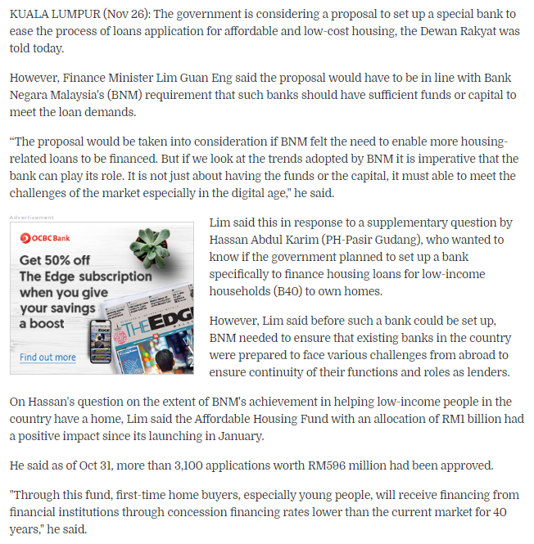
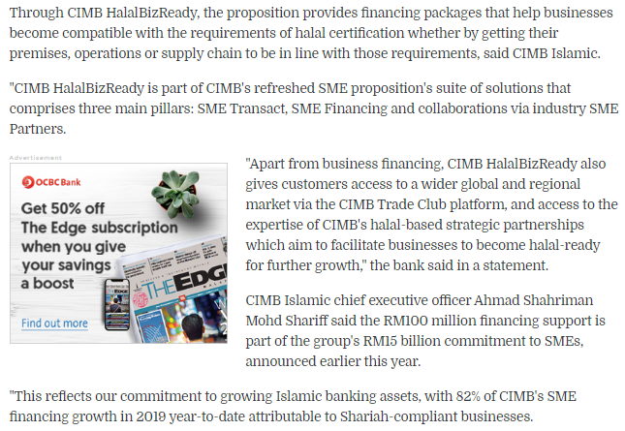
News Categorization (Rule-Based)
This article only contain one stock (“CIMB”), therefore categorized as “Stock-Specific News”
Article contain general industry term “Financial Institutions” and “BNM” but without Stock Quote, therefore categorized as “Sector News”. Multiple rules need to be developed.

Slide 23
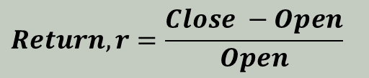
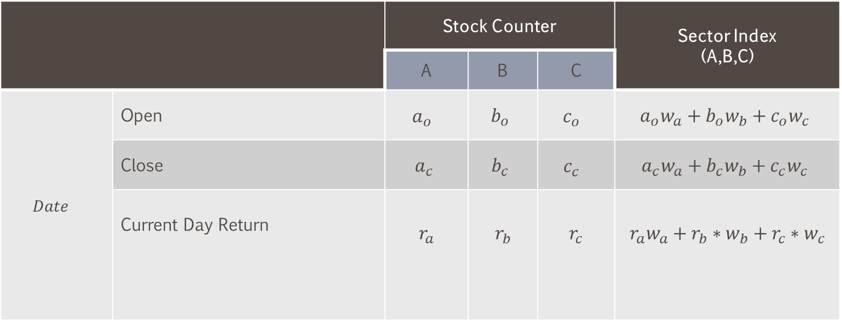
Measuring Return
 |  | Stock Counter |  |  | Sector Index (A,B,C)
 |  | A | B | C
$${Date}_{}$$ | Open | $$a_{o}$$ | $$b_{o}$$ | $$c_{o}$$ | $$a_{o}w_{a}+b_{o}w_{b}+c_{o}w_{c}$$
 | Close | $$a_{c}$$ | $$b_{c}$$ | $$c_{c}$$ | $$a_{c}w_{a}+b_{c}w_{b}+c_{c}w_{c}$$
 | Current Day Return | $$r_{a}$$ | $$r_{b}$$ | $$r_{c}$$ | $$r_{a}w_{a}+r_{b}∗w_{b}+r_{c}∗w_{c}$$
[Li at el., 2014]
[TheEdge, refer below]
$$Return, r=\frac{Close −Open}{Open}$$
[Li at el., 2014]
Each sector contain top 10 large market capital stocks (Example shows only single sector with only 3 stocks A,B,C)
We follow weighting by market capitalization similar to KLCI (refer https://www.theedgemarkets.com/article/analysing-fbm-klci)

Slide 24
Labeling Price Direction
Close
Open
Legend
Current return is based on current Close- current Open
Future return is measured on Future Close – Current Open
Price direction is labeled based on return into Up/NoChange/Down zone
NoChange boundary of ±0.2% reflecting trading cost
We hope to find that If text sentiment is strong enough, investor will make decision to profit beyond the boundary
Up
Open
Close
Labels
Up
Return
1.4%
NoChange
Return
1.2%
Up
Return
0.1%
Current Open
+0.2%
NoChange
D0
(current)
D1
(future)
D2
(future)
D3
-0.2%
Return
-0.3%
Down
Down

Slide 25
Implementation Design
News Article Database
Azure SQL
Pricing Data (Yahoo Finance)
Web
Google API
Relevant News Tag to Stock/Sector
Keyword List (manual)
Calculate Current and Future Return
Python Web scrap
Break into Header/Body
Calculate Current and Future Price Direction (Label)
Accuracy
F1 Means
Precision
Recall
Split Into Sentences
Classify (Prediction)
Join
Analyze Performance
For Each Sentence
No More Sentence
Aggregate Multiple Articles Sentiment Scores
Aggregate News
Sectors/Stock-Specific news
Header/Body news
 |  |  |  | Label (Price Direction)
Stock | Date | Aggregated Sentiment Score | Prediction | D₀ Return | D₁ Return | D₂ Return
 | D₀
 | D₁
 | D₂
 | D₃
Part Of Speech tag on each word
Next Sentence
NLTK
Score each word to Positive/Neutral/
Negative
Python
SentiWordNet

Slide 26
References
[Tetlock, 2007] Tetlock, P. C. (2007). Giving content to investor sentiment: The role of media in the stock market.The Journal of finance, 62(3):1139–1168.
[Tetlock et al., 2008] Tetlock, P. C., Saar-Tsechansky, M., and Macskassy, S. (2008). More than words: Quantifying language to measure firms’ fundamentals.The Journal of Finance, 63(3):1437–1467
[Loughran and McDonald, 2011] Loughran, T. and McDonald, B. (2011). When is a liability not a liability? textual analysis, dictionaries, and 10-ks.TheJournal of Finance, 66(1):35–65.
[Hagenau et al., 2012] Hagenau, M., Liebmann, M., Hedwig, M., and Neumann, D. (2012). Automated news reading: Stock price prediction based onfinancial news using context-specific features. In2012 45th Hawaii International Conference on System Sciences, pages 1040–1049. IEEE.
[Schumaker and Chen, 2009] Schumaker, R. P. and Chen, H. (2009). Textual analysis of stock market prediction using breaking financial news: The azfintext system.ACM Transactions on Information Systems (TOIS), 27(2):12.
[Nassirtoussi et al., 2015] Nassirtoussi, A. K., Aghabozorgi, S., Wah, T. Y., and Ngo, D. C. L. (2015). Text mining of news-headlines for forex marketprediction: A multi-layer dimension reduction algorithm with semantics and sentiment.Expert Systems with Applications, 42(1):306–324.
[Li et al., 2014] Li, X., Xie, H., Chen, L., Wang, J., and Deng, X. (2014). News impact on stock price return via sentiment analysis.Knowledge-BasedSystems, 69:14–23.
[Kim et al., 2014] Kim, Y., Jeong, S. R., and Ghani, I. (2014). Text opinion mining to analyze news for stock market prediction.Int. J. Advance. SoftComput. Appl, 6(1):2074–8523.
[Tan et al., 2014] Tan, L., Phang, W., Chin, K., Alfred, R., and Anthony, P. (2014). Impact of financial news headline and content to market sentiment.
[Hor et al., 2018] Hor, W.L., Goh, W.X., and Ow, S. H. (2018). Impact of news sentiment analysis on market price movement during the dividend period.International Journal of Engineering & Technology, 7(4.11):168–173.

Slide 27
Thank You

Slide 28
Images FOR THESIS

Slide 29

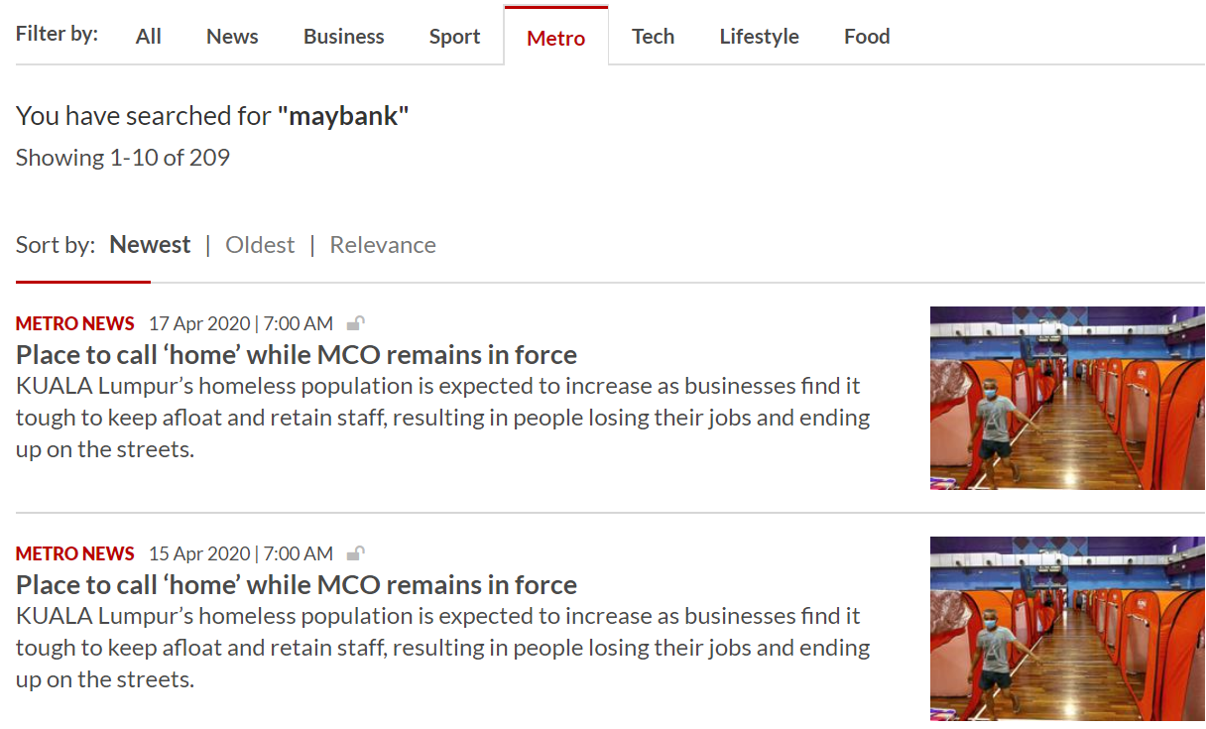
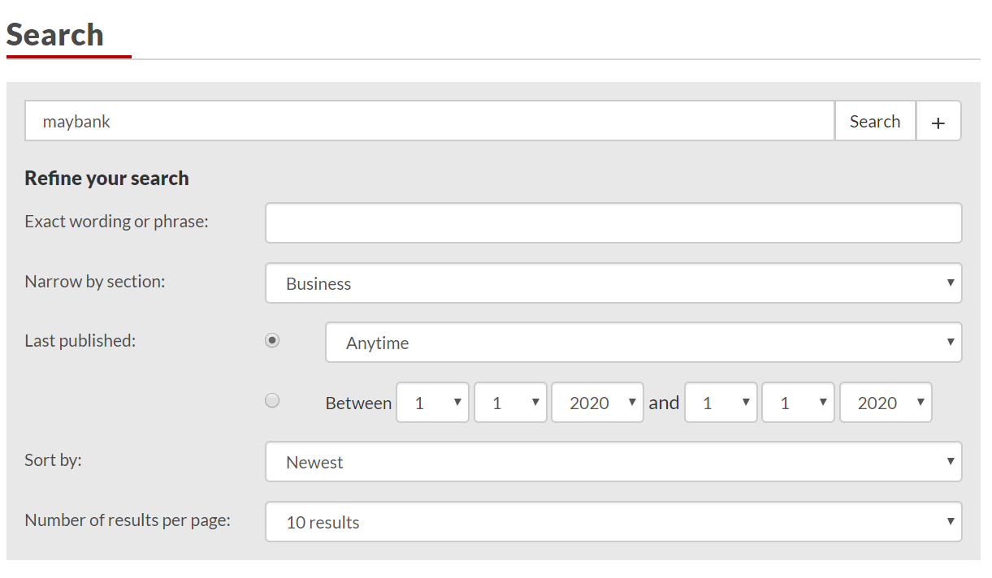
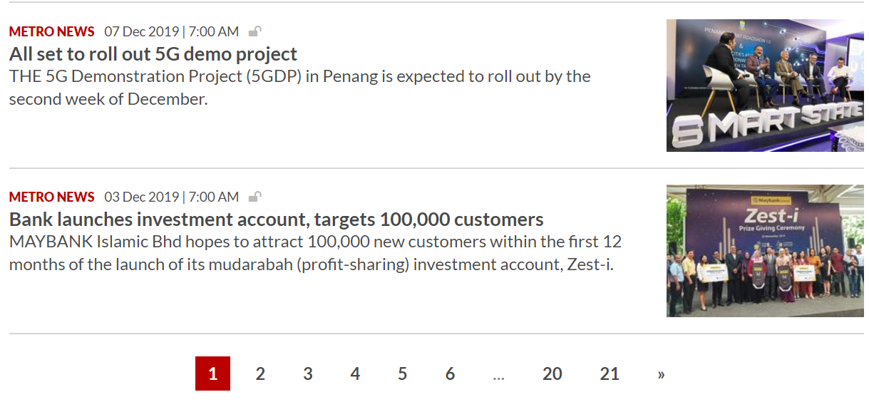
Search Results (multi pages)
Http Search Parameters:
https://www.thestar.com.my/search/?q=maybank&qguid=&qtag=33%2C76&QDR=QDR_simple&DateRange_DDL=anytime&qsort=newest&qrec=10&adv=1
URL link to Article Page
Loop through pages to fetch all article links

Slide 30
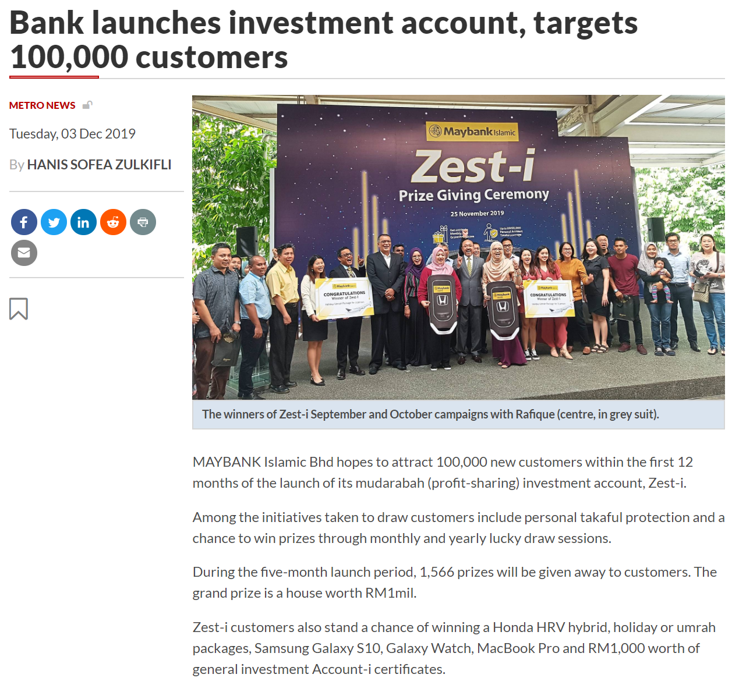
News Headline
Timestamp
News Article

Slide 31




Local File Storage (csv files)
Python Environment
Internet Data Sources
NewsDatabase Object
Stock Listing with RIC and Company Name)
Keywords
FetchLinksFromKeywords(*kw)
Unique Links
News Articles
Content Parsing and Deduplication
FetchNewsFromLinks()
Unstructured Data (Text)
EikonDatabase
Object
Historical
OpenPrice, ClosePrice,
MarketCap
RefreshPricing(*stock)
Stock Price History
Structured Data (numerical)
Python Environment
Data Preprocessing
Feature Engineering
Data Modeling
Results

Slide 32
Database Schema
Instruments
*RIC
Keywords
Sector
StockPrice
RIC
Date
OpenPrice
ClosePrice
MarketCap
News
*ID
Date
Healine
Detail
Source
Link
1
M

Slide 33
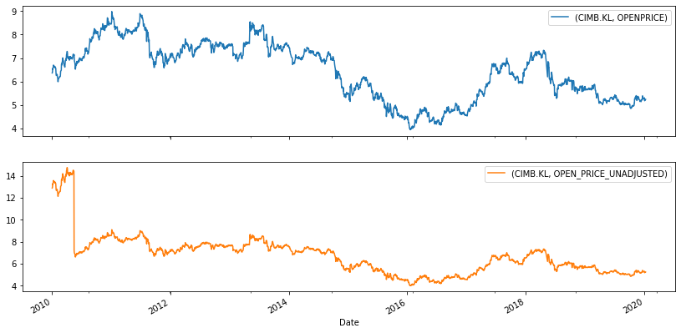
Adjusted vs Non Adjusted Share Price
Price Adjusted Chart
Bonus Issue 1:1
2010-05-31
Price Unadjusted Chart

Slide 34
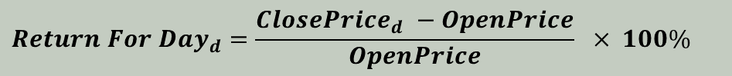
Calculating Returns for Next 5 days
$$Return For {Day}_{d}=\frac{{ClosePrice}_{d} −OpenPrice}{OpenPrice} × 100\%$$
Close
8.85
% of Return Based on Day0
Close
8.83
Close
8.79
Open
8.75
Share Price
Close
8.67
Close
8.66
Close
8.65
Day0
2019-11-08
Day0
Day1
Day2
Day3
Day4
Day5

Slide 35
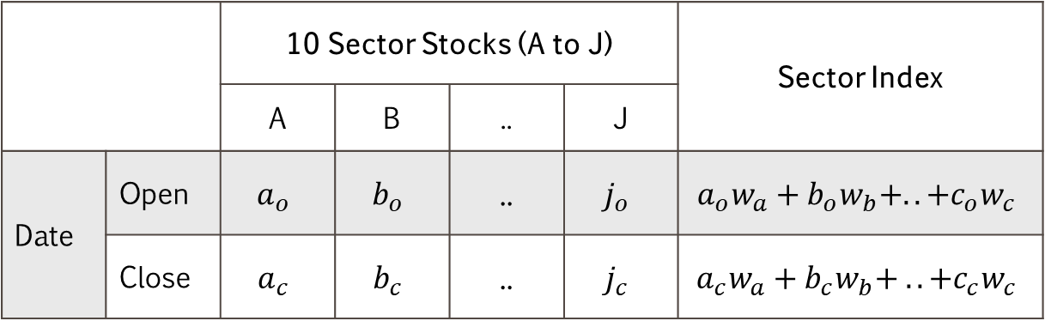
Calculating Returns For Sector Index
 |  | 10 Sector Stocks (A to J) |  |  |  | Sector Index
 |  | A | B | .. | J
Date | Open | $$a_{o}$$ | $$b_{o}$$ | .. | $$j_{o}$$ | $$a_{o}w_{a}+b_{o}w_{b}+.. +c_{o}w_{c}$$
 | Close | $$a_{c}$$ | $$b_{c}$$ | .. | $$j_{c}$$ | $$a_{c}w_{a}+b_{c}w_{b}+ ..+c_{c}w_{c}$$

Slide 36
Split Into Sentences
Article Header
Article Detail
Cleanup Null Values and remove Chinese news
Read News From Database
For Each Sentence
Tokenize Sentence Into Words
Final Sentiment (Combined Score)
Part Of Speech tag sentence into (word, POS tag) tuples
Average Header and Detail WN Sentiment Scores
For Each (Word, POSTag) tuple
Classify each tuple into Positive or Negative with SentiWordnet Dictionary
Header Sentiment Score
Detail Sentiment Score
Accumulate Positive and Negative word counts
Yes
Yes
Anymore (Words,POSTag) tuple?
Anymore Sentence ?
Calculate WN Sentiment Score Separately for Header and Detail
No
No

Slide 37
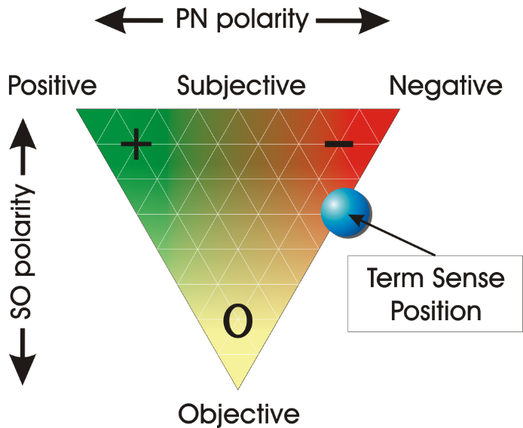
Senti WordNet
Pos (term) + Neg (term) + Obj (term) = 1

Slide 38
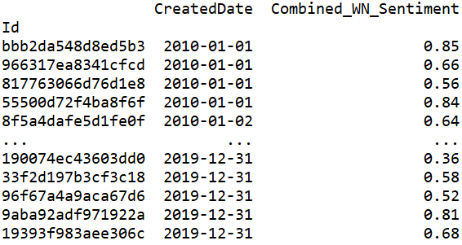
Combining Sentiment Scores
News Article
Sentiment Score for Header
Sentiment Header
O
N
N
Combined Sentiment Score (Average)
Sentiment Detail
P
O
N
P
Sentiment Score Detail
P
N
O
P
P: Positive Term,
N: Negative Term,
O: Objective Term
(Blank): Not in SWN Dictionary

Slide 39
Number of News vs Market Capital

Slide 40
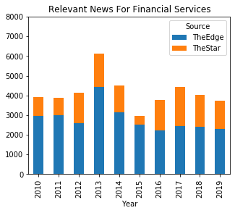
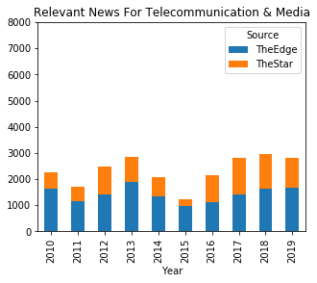
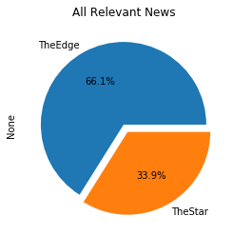
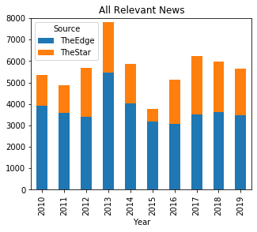
Relevant News Count

Slide 41
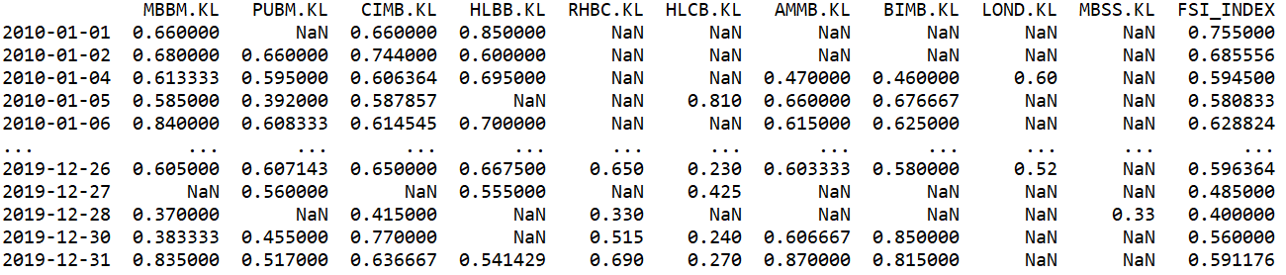
News Entity Mapping
MBBM.KL PUBM.KL CIMB.KL HLBB.KL RHBC.KL HLCB.KL AMMB.KL BIMB.KL LOND.KL MBSS.KL FSI_INDEX
Id
bbb2da548d8ed5b3 False False False True False False False False False False True
966317ea8341cfcd True False True False False False False False False False True
817763066d76d1e8 False False False False False False False False False False False
55500d72f4ba8f6f False False False False False False False False False False False
8f5a4dafe5d1fe0f False False False False False False False False False False False
... ... ... ... ... ... ... ... ... ... ...
190074ec43603dd0 False False True False False False False False False False True
33f2d197b3cf3c18 False True False True False False False False False False True
96f67a4a9aca67d6 False False True False False False False False False False True
9aba92adf971922a True False False False False False False False False False True
19393f983aee306c False True True False False False False False False False True

Slide 42
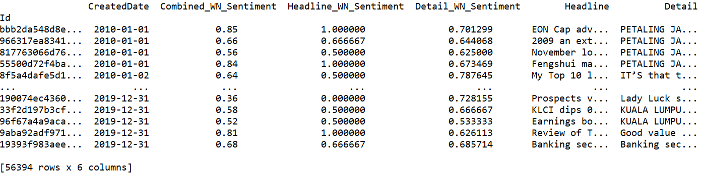
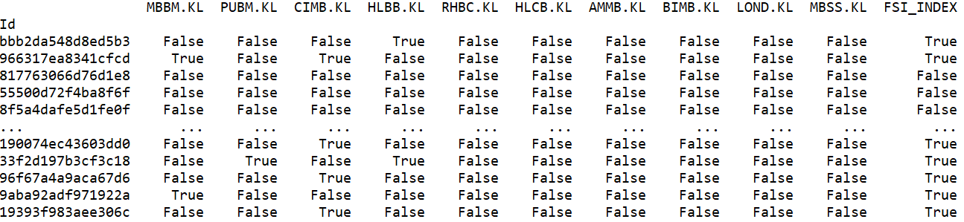
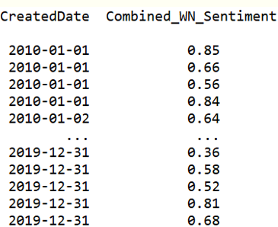
Merging Sentiment To Entity
News Sentiment DataFrame
From News Stock Mapping DataFrame
From News Sentiment DataFrame

Slide 43
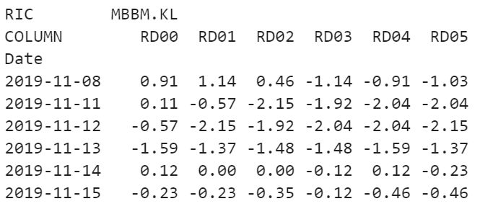
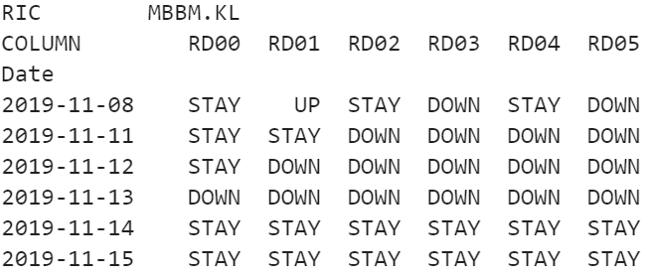
Returns Label for Current to next 5 Days
Current and Future 5 Days Returns (%)
Price Direction Labels

Slide 44
Modeling
0.00
Returns Label (Actual)
Prediction
RD00
RD01
RD02
RD03
RD04
RD05
News
Sentiment Scores
DOWN
DOWN
DOWN
DOWN
DOWN
DOWN
DOWN
-th
STAY
STAY
STAY
STAY
STAY
STAY
STAY
centre
UP
UP
UP
UP
UP
UP
UP
+th
1.00
Accuracy, F1 Means
Result_{RD00}
Result_{RD01}
Result_{RD02}
Result_{RD03}
Result_{RD04}
Result_{RD05}
Baseline
Parameters Search
centre: 0.1, 0.2 .. 0.9
th: 0.01, 0.02 .. 0.99
Evaluate
Averaged Results
Averaged Baseline

Slide 45
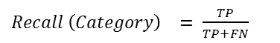
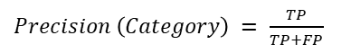
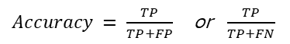
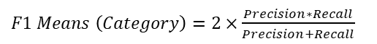
Performance Evaluation Metrics
$Precision \left(Category\right) = \frac{TP}{TP+FP}$
$Recall \left(Category\right) = \frac{TP}{TP+FN}$
$F1 Means \left(Category\right)=2×\frac{Precision∗Recall}{Precision+Recall}$
$Accuracy = \frac{TP}{TP+FP}$ or $\frac{TP}{TP+FN}$

Slide 46
Stocks Returns Label

Slide 47
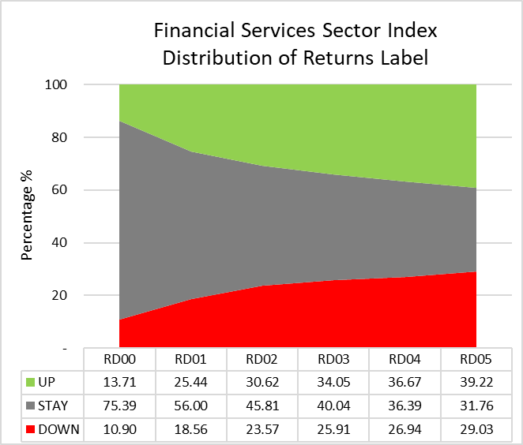
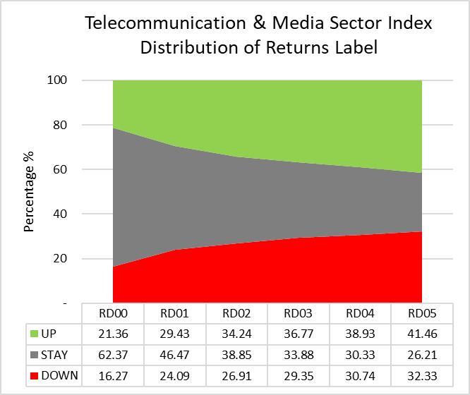
Sector Index Returns Label

Slide 48
Baselining Method
Focus Group: can be FS, TELCO or INDEX
Distribution of Returns Labels (%)
Represents F1 Means for RD0X
Average all F1 Means to get baseline, for each Category
Labels
Average all Accuracy to get baseline
Represents Max accuracy for RD0X

Slide 49
Group Baselines

Slide 50
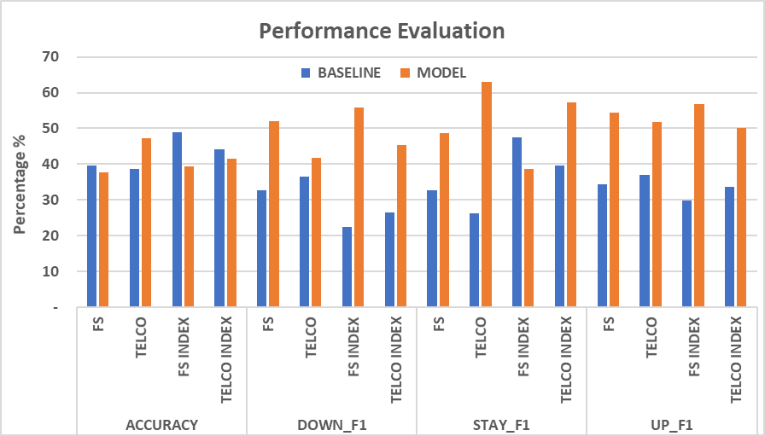
Group Results

